Slide 1
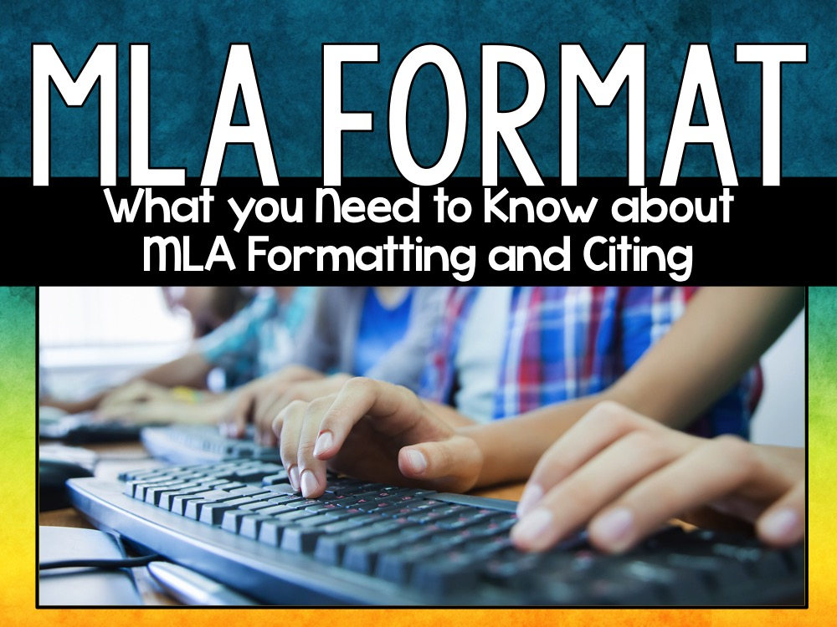

Slide 2

MLA Format
MLA (Modern Language Association)
Most commonly used to write papers and cite sources for liberal arts and humanities

Slide 3
Why Use MLA Format?
MLA style gives writers a system for citing their sources (parenthetical citations and Works Cited pages)
Writers who use MLA style build their credibility

Slide 4
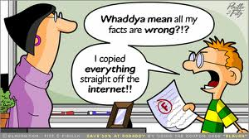
Why Use MLA Format?
It protects you from plagiarism accusations

Slide 5
Paper Guidelines
Use standard, white 8.5 x 11-inch paper
Double-space the text of your paper
Standard font (Times, Calibri, Arial, Cambria, etc.)
12 point font
Leave only one space after periods or other punctuation marks
One inch margins on all sides of your document
Use the tab key to indent each paragraph

Slide 6
The 1st Page of the Paper
No title page
In the upper left-hand corner of the first page, list:
your name
instructor's name
course title
date the assignment is due (day month year)
Add a header in the upper right-hand corner of the document
Last Name page number ex: Smith 1
Center the title and type it in plain text
Use italics when referring to other works in your title

Slide 7
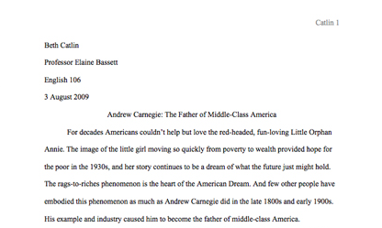
First Page Example
Header
One inch margin
Heading
Paper Title
Indented paragraph
One inch margin
One inch margin

Slide 8
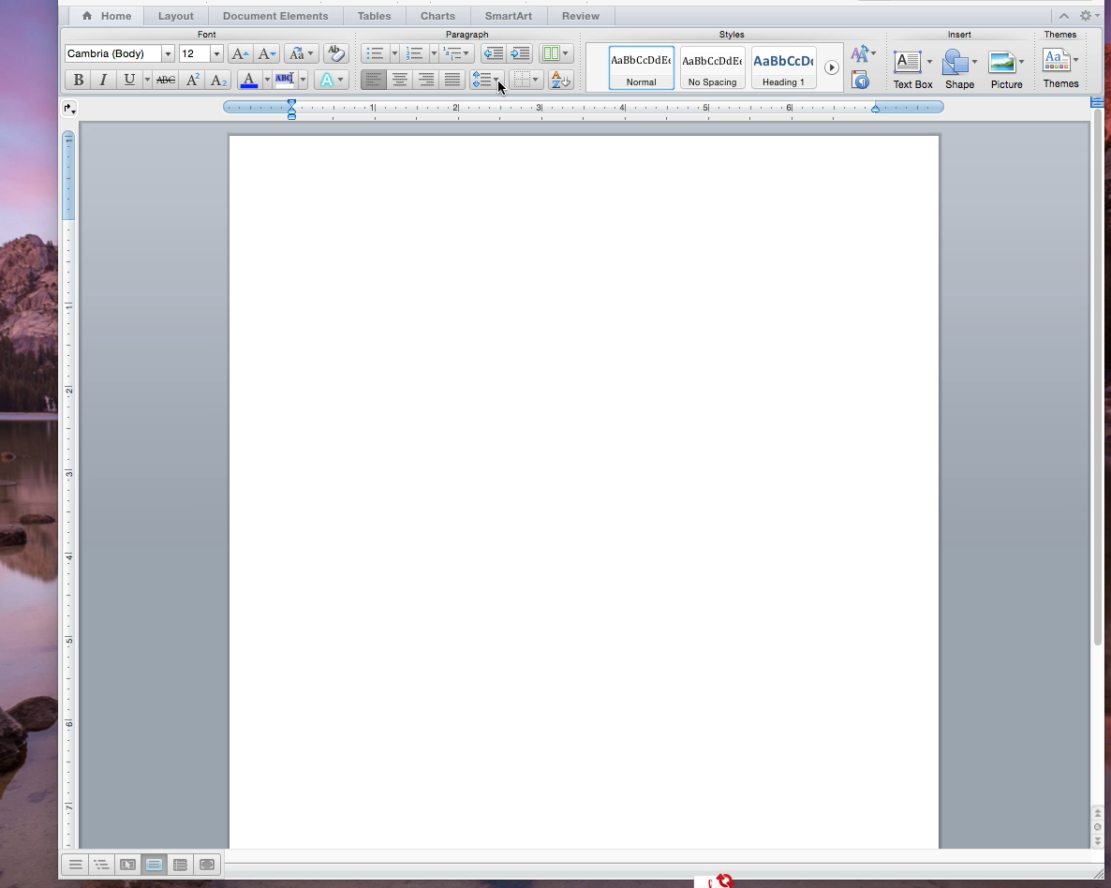
EXAMPLE VIDEO

Slide 9
Works Cited Page
To create a Words Cited page…
Create your Works Cited page on a new page in the same document
Label the page Works Cited in the center
Double space all citations, but do not skip spaces between entries
Create a hanging indent for all listings
List entries in alphabetical order

Slide 10
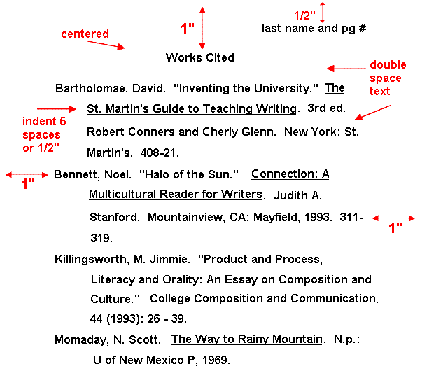

Slide 11
How to Cite Web Sources
Entire Web site
Author’s or Editor’s last name, first name [if given]. Name of Site. Version number, Name of sponsor or publisher. Date resource was created. URL. Date of access.

Slide 12
How to Cite Web Sources
Article from a Web site
Author’s or Editor’s last name, first name [if given]. “Title of Article.” Title of web site. Publisher Name, publication date. URL. Date of access.

Slide 13
How to Cite Web Sources
Article in an Online Database/ Scholarly Journal
Author’s or Editor’s last name, first name [if given]. “Article Title.” Title of Publication, any volume or issue number, year of publication. Electronic Subscription Service, DOI.

Slide 14
How to Cite Print Sources
Encyclopedia
Author’s last name, first name. [if available] “Article Title.” Title of Encyclopedia. Year Published. Print.

Slide 15
How to Cite Print Sources
Book with One Author
Last name, first name. Title of Book. Publisher, Date published.

Slide 16
How to Cite Print Sources
Book with Two Authors
Last name, first name and first name last name. Title of Book. Publisher, Date published.
Book with Three or More Authors
Last name, first name, et al. Title of Book. Publisher, Date published.

Slide 17
How to Cite Print Sources
Book with an Editor
Author’s last name, first name. Title of Book. Edited by editor first name last name Publisher, Date published.

Slide 18
Parenthetical Citation
A parenthetical citation is a citation in the text of your writing to let your readers immediately know where you got your source
*Your parenthetical citation will be the first part of the entry from the Works Cited page
*The period goes outside of the parenthesis.

Slide 19


MLA Citations
Columbia University Professor Jeffrey Johnson spent seventeen years
recording the viewing habits of children in 707 families in Upstate New
York and found that the ones “who watched one to three hours of television
each day . . . were 60% more likely to be involved in assaults and fights as
those who watched less TV” (“Research on the Effects of Media Violence”).
Works Cited
“Research on the Effects of Media Violence.” Media Awareness Network.
2005. www.url.com. 12 Mar. 2005

Slide 20
Works Cited Entry for a Book
The ideal context for identity
formation is “a supportive and
respectful family” (Levine 169).
Works Cited
Levine, Madeleine, Ph.D. See No Evil: A Guide to Protecting Our Children from Media Violence. San Francisco, 1998.

